Slide 1
Case Study 14
Race Condition in XV6 Shared Data
Operating Systems | Department of CSE
L Nithish Kumar Goud | 160124733327
G Ishan | 160124733322
Santhosh | 160124733332
Venkat | 160124733340
Chaitanya Bharathi Institute of Technology | Faculty / semester / year: __________
Notes:
This case study examines shared kernel data in xv6 on four CPUs. Team names and roll numbers follow the supplied division document. Faculty, semester, and academic year remain blank for the department to complete.

Slide 2
Case Study 14: Required scope
Problem Statement: Study how race conditions can occur when multiple processes or CPUs access shared kernel data without proper synchronization.
Analyse how XV6 prevents inconsistent updates using locking mechanisms.
Objectives: understand races and critical sections, identify shared data, explain mutual exclusion, observe concurrent updates, and explain how locks preserve consistency.
Activities: inspect the free list and its lock, reason about lock removal, record possible two-CPU outcomes, then restore locking and compare. Expected outcome: explain safe shared-data access.
02
Notes:
The assignment studies the physical-memory free list as the shared structure. The project compares original locking, a temporary four-call removal, and restoration. The activity and expected outcome follow the supplied faculty guideline.

Slide 3
1. What is a race condition?
A race occurs when shared-state correctness depends on the interleaving of concurrent operations.
In xv6, concurrent kalloc() calls can read the same kmem.freelist head.
Table 1. A stale free-list head can assign page P twice
Step | CPU 0: kalloc() | CPU 1: kalloc()
1 | r0 = freelist = P | r1 = freelist = P
2 | freelist = P->next | freelist = P->next
3 | return P | return P
Two callers may return P and corrupt separate processes' data.
03
Notes:
A race is a correctness defect whose outcome depends on how concurrent operations interleave. The xv6 example is the allocator: without kmem.lock, CPU 0 and CPU 1 can both read P as the free-list head, both advance the head from the same stale pointer, and both return P. This is a source-level possible schedule, not a trace claimed for any one recorded failure.

Slide 4
2. Problems generated by race conditions
A lost head update can remove a free page from the list.
Two allocators may both return the same physical page.
Broken links can cause allocator corruption, failures, or kernel traps.
Shared-state errors can spread into unrelated processes and kernel work.
Timeout is an observation, not a deadlock diagnosis.
04
Notes:
The allocator invariant requires each free physical page to appear exactly once in the free list and never be returned to two callers at once. Violating that invariant can lose pages, corrupt memory, or crash the kernel. A race and a deadlock describe different problems.

Slide 5
3. How can race conditions be solved?
Protect every shared update with the lock associated with that data.
Include dependent reads and writes in the same critical section.
Use atomic lock ownership with acquire and release ordering.
Keep the protected section short and use one locking discipline.
The xv6 allocator already uses kmem.lock; this study restores it.
05
Notes:
The solution preserves the invariant by serializing the complete free-list push or pop. In the tested xv6 revision, acquire and release use atomic operations with acquire and release ordering. The experiment restores the existing lock rather than adding a new one.

Slide 6
4. What is synchronization?
acquire(): push_off() disables local interrupt re-entry.
while (__atomic_exchange_n(&lk->locked, 1, __ATOMIC_ACQUIRE)) ;
Critical section: mutate kmem.freelist and r->next as one operation.
__atomic_store_n(&lk->locked, 0, __ATOMIC_RELEASE); pop_off();
Atomic ownership excludes other CPUs; interrupt masking alone cannot.
06
Notes:
This is the checked xv6 implementation from kernel/spinlock.c. acquire() calls push_off(), rejects recursive ownership, and spins on an atomic exchange with acquire ordering. release() checks ownership, clears the owner record, publishes protected stores with release ordering, then calls pop_off(). Atomic exchange provides cross-CPU exclusion; push_off handles local interrupt nesting.

Slide 7
5. Types of synchronization
Table 2. Common synchronization methods
Method | Suitable purpose
Mutex / spinlock | Exclusive access; sleep or busy-wait as appropriate
Semaphore | Available permits or bounded resources
Condition variable / monitor | Wait for a state predicate under an exclusion rule
Reader-writer lock | Concurrent readers; exclusive writers
Barrier | Wait for all participants at a phase boundary
Atomic operation | Indivisible update; not a whole-object guarantee
Only xv6’s allocator spinlock was tested in this case study.
07
Notes:
A spinlock provides exclusive access while a CPU waits actively. A semaphore manages permits, a condition variable lets a thread wait for a predicate under a mutex, a reader-writer lock permits concurrent readers, and a barrier waits for a group phase. Atomic operations protect indivisible updates but do not automatically protect a multi-step object invariant. Only the allocator spinlock was measured here.

Slide 8
6. How xv6 protects the shared free list
/* kalloc(): remove one free page */
acquire(&kmem.lock);
r = kmem.freelist;
if (r) kmem.freelist = r->next;
release(&kmem.lock);
/* kfree(): add one free page */
acquire(&kmem.lock);
r->next = kmem.freelist;
kmem.freelist = r;
release(&kmem.lock);
Figure 1. kalloc() and kfree() update the free list inside kmem.lock.
08
Notes:
kernel/kalloc.c declares kmem.freelist and kmem.lock. kalloc acquires the lock before reading the head and advancing it. kfree acquires it before linking a page to the head. kernel/spinlock.c and spinlock.h implement initlock, acquire, release, holding, push_off, and pop_off. Source: https://github.com/mit-pdos/xv6-riscv/blob/f780d7850765d74cbdcd1fff4b822d8829f7c9bd/kernel/kalloc.c and https://github.com/mit-pdos/xv6-riscv/blob/f780d7850765d74cbdcd1fff4b822d8829f7c9bd/kernel/spinlock.c

Slide 9
7. C file: user/race_test.c
The parent forks four workers, waits for all four, then writes one gate token per child.
Each worker requests eight pages, fills a child-specific tag, rereads 32 KiB, then shrinks.
volatile uchar *memory = (volatile uchar *)allocation;
for (int offset = 0; offset < bytes; offset++)
memory[offset] = tag;
Any pipe/fork error or non-zero wait() status makes the run fail.
The worker repeats this allocate-write-check-free cycle for 200 rounds.
09
Notes:
The guest C program uses a pipe as a start gate, forks four children, and only releases them after all workers exist. Each worker repeats 200 rounds of sbrk(8*4096), writes a unique byte tag across the 32 KiB allocation, waits briefly in user space, rereads each byte, then calls sbrk(-bytes). The parent verifies every wait() status. volatile requests fresh reads in this test; it does not synchronize the kernel or prevent aliasing of a physical page.

Slide 10
7. C file: member1_tools.c and WSL commands
Host C helper builds xv6, launches QEMU, records each attempt, and restores kalloc.c.
Its run, package, and replay modes validate, summarize, and replay saved evidence.
PowerShell: wsl -d Ubuntu-24.04
cd ~/xv6-member1
git rev-parse HEAD
make -j4 kernel/kernel fs.img
make qemu CPUS=4
# xv6 shell: echo hello xv6; usertests -q; race_test
The allocation path ends in kalloc(); shrink reaches kfree().
10
Notes:
member1_tools.c is the host C runner. Its helper functions handle paths, file loading and saving, subprocess execution, checked commands, build recording, result messages, run timing, CSV rows, manifests, package creation, restoration, and replay. In the guest, user/ulib.c sbrk reaches kernel/sysproc.c sys_sbrk, kernel/proc.c growproc, kernel/vm.c uvmalloc or uvmdealloc, then kernel/kalloc.c kalloc or kfree. The command shown is a reproducible WSL sequence; the measured C-runner set was automated through run mode.

Slide 11
Experiment environment and fixed protocol
Table 4. Recorded environment and run controls
Setting | Recorded configuration
Guest / host | RISC-V xv6 / Ubuntu 24.04 under WSL2
Emulator / compiler | QEMU 8.2.2 / RISC-V GCC 13.3.0
Resources | 4 CPUs; 128 MiB RAM
Workload | 4 children; 8 pages each; 200 rounds
Attempts | 10 per phase; fresh guest per attempt
Limits | 30 s to shell; 60 s after stress command
Original observations and C-runner validation are separate 30-attempt sets.
11
Notes:
The source revision is f780d7850765d74cbdcd1fff4b822d8829f7c9bd. Environment: Ubuntu 24.04 under WSL2, QEMU 8.2.2, RISC-V GCC 13.3.0, four CPUs, and 128 MiB guest RAM. Every attempt booted a fresh guest. The host used a 30 second shell timeout and 60 seconds after starting the stress test. All attempts reached the shell and started the test. No kernel timing instrumentation was used.

Slide 12
8. What the lock prevents: two-CPU examples
Table 3. Possible kalloc() schedule without kmem.lock
Step | CPU 0 | CPU 1
1 | Read head P
2 |  | Read head P
3 | Set head to P.next
4 |  | Set head to P.next
5 | Return P | Return P
The same lock protects kfree() from overwriting a concurrent head update. These are possible schedules, not recorded instruction traces.
12
Notes:
Without kmem.lock, two CPUs can read the same free-list head P before either advances it, and both may return P. During concurrent frees, CPU 0 may link page A to old head F while CPU 1 links page B to F and overwrites the head with B, losing A. These are source-level possibilities. The logs do not identify an exact internal interleaving.

Slide 13
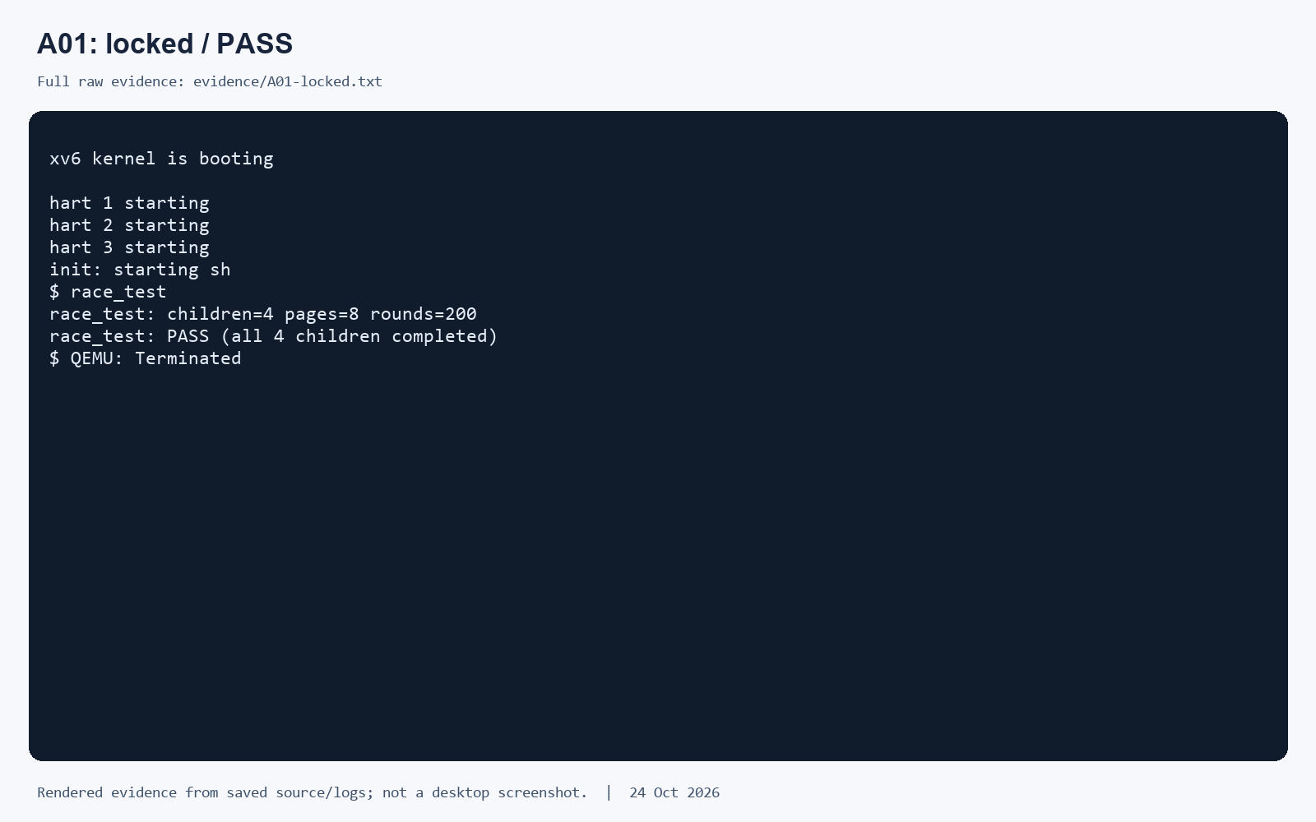
Original set: locked baseline A01
Figure 2. Rendered excerpt from saved original-set log A01; not a desktop screenshot.
13
Notes:
Rendered excerpt from saved original-set log A01, not a native desktop screenshot. The original locked phase had 10 PASS outcomes in 10 attempts. Full logs are in member1_completed/evidence/.

Slide 14
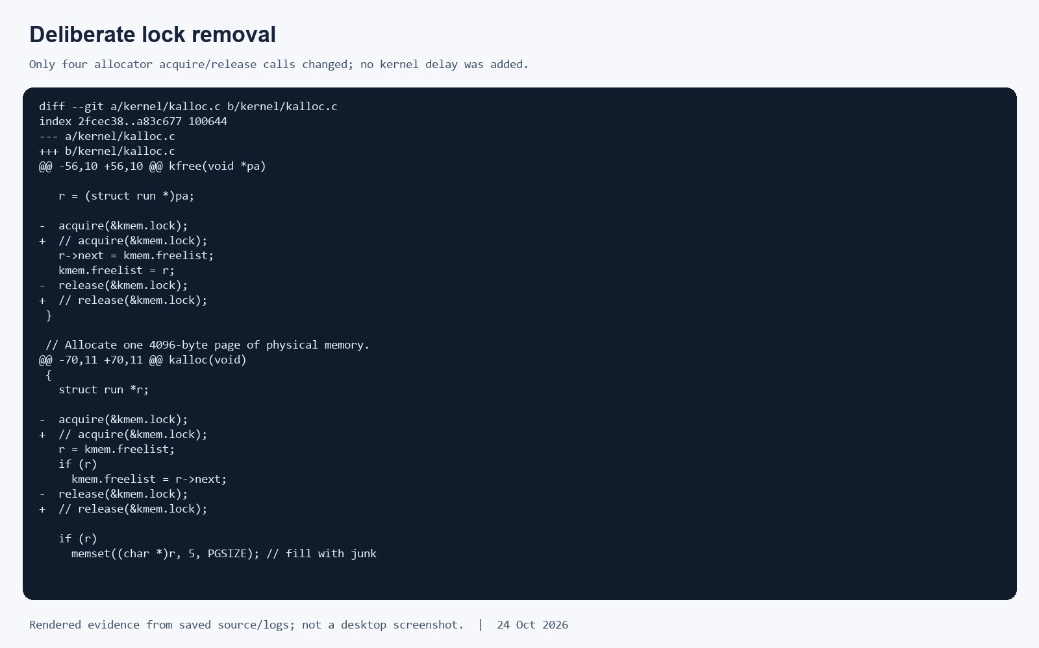
Controlled removal of allocator locking
Figure 3. Rendered source excerpt: four acquire/release calls removed; workload unchanged.
14
Notes:
The experimental variant comments out acquire and release in both kalloc() and kfree(), four calls total. The free-list operations and workload stay unchanged. Removing the calls also removes their local interrupt-handling effects when no outer lock is active, so the experiment does not isolate those effects.

Slide 15
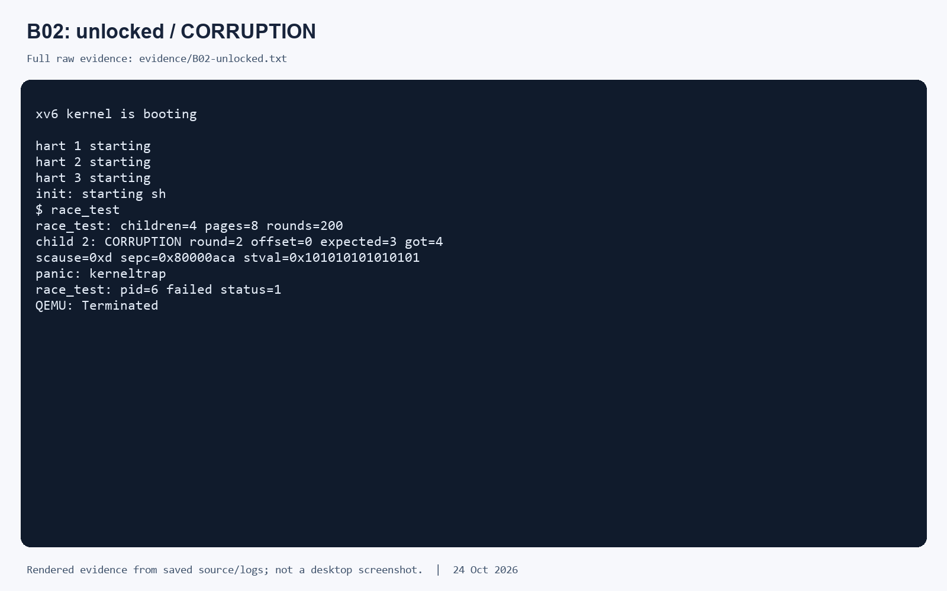
Original set: unlocked run B02
Figure 4. Rendered excerpt from saved original-set log B02; not a desktop screenshot.
15
Notes:
Rendered excerpt from original-set log B02. Its primary CSV category is CORRUPTION even though the same output also includes a kernel trap. The original unlocked phase had three corruption outcomes, four panic or trap outcomes, two test failures, and one timeout. Do not infer a specific instruction interleaving from this output.

Slide 16
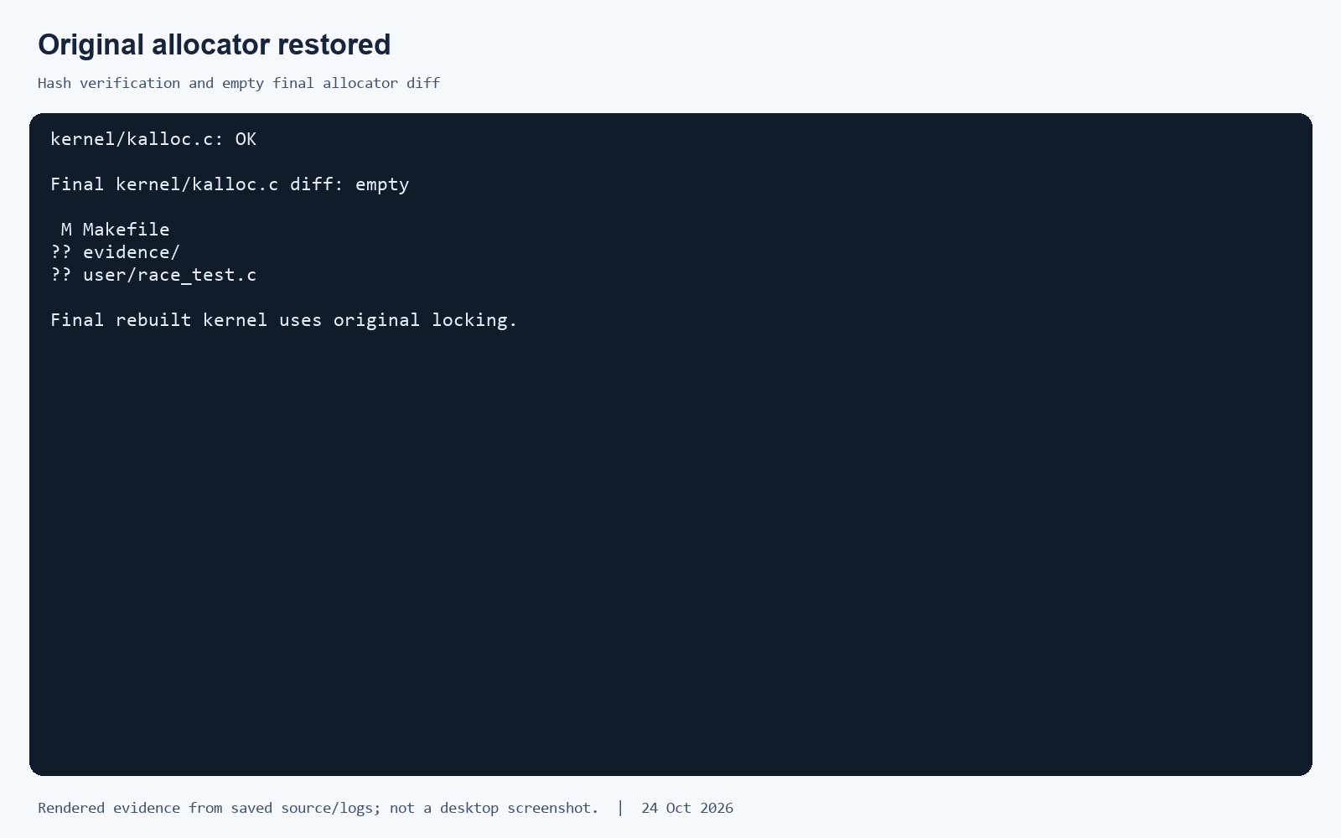
Original allocator restored and verified
Figure 5. Rendered restoration checks from saved artifacts; restored phase: 10/10 PASS.
16
Notes:
Saved restoration evidence shows the allocator hash check and empty final allocator diff. The final kernel was rebuilt with the original locks. In the original set, all ten restored attempts passed. This is a rendered excerpt from saved files, not a desktop screenshot.

Slide 17
Implementation workflows
GUEST ALLOCATION PATH | 4 children × 8 pages × 200 rounds
race_test.c
4 forked workers
sbrk(bytes)
user/ulib.c
sys_sbrk()
kernel/sysproc.c
growproc() → uvmalloc()
kalloc()
kmem.lock
The same path reverses on shrink: uvmdealloc() → uvmunmap() → kfree().
HOST C RUNNER | controlled phases and restoration evidence
A: LOCKED
original allocator
B: UNLOCKED
comment exactly 4 calls
C: RESTORED
write saved bytes + rebuild
VERIFY
hash + empty diff + CSV
Restoration guard in member1_tools.c
must_restore = 1; atexit(restore);
Each attempt boots a fresh QEMU guest. The host captures raw console output, classifies one primary outcome, and appends the run ID and log path to results.csv.
17
Notes:
Implementation diagram based on the checked source and recorded host workflow. Guest growth: user/race_test.c → user/ulib.c sbrk → kernel/sysproc.c sys_sbrk → kernel/proc.c growproc → kernel/vm.c uvmalloc → kernel/kalloc.c kalloc. Shrink reaches uvmdealloc/uvmunmap and kfree. Host phases are controlled by member1_tools.c: baseline with four lock calls present, a deliberate edit of exactly four acquire/release calls, then byte-for-byte restoration and rebuild. atexit(restore) handles normal C process termination; it cannot guarantee recovery after power loss or forced termination. Evidence CSV and raw logs remain separated by dataset.

Slide 18
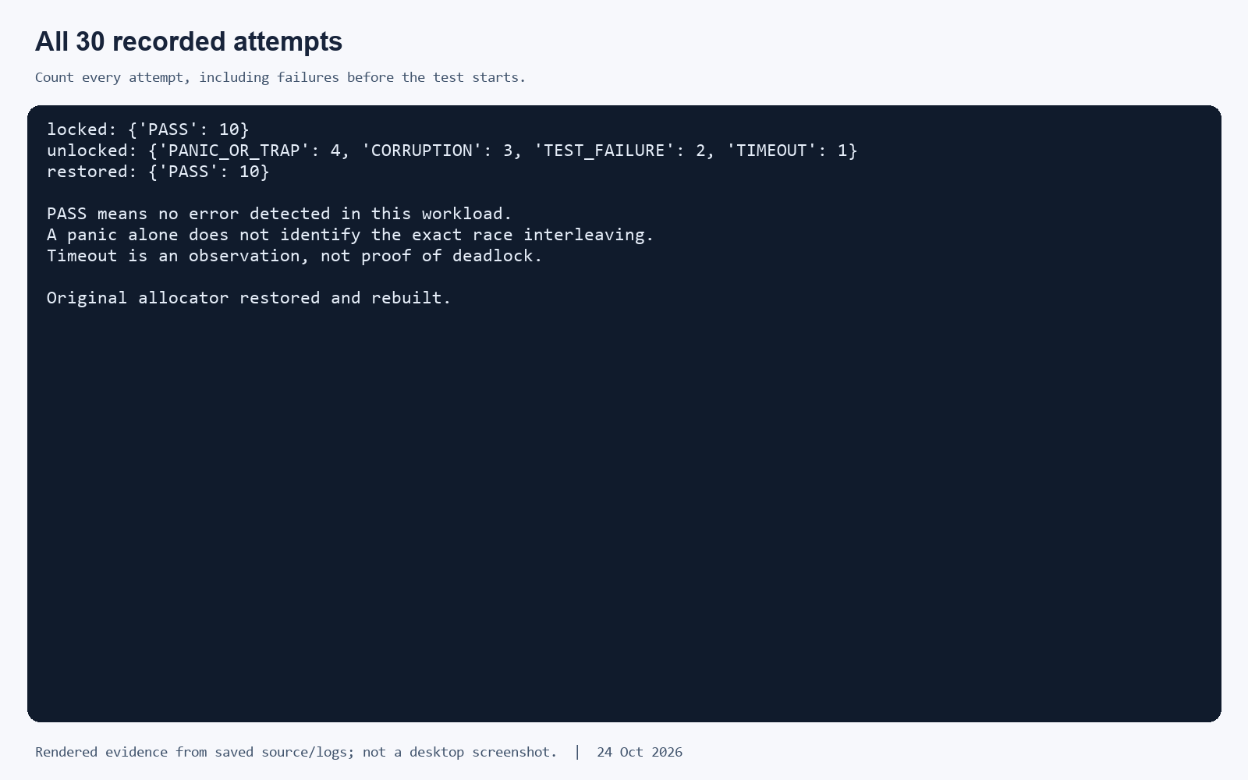
9. Results comparison and limits
Table 5. Original run-set outcome totals
Phase | PASS | Other
Locked | 10 | 0
Unlocked | 0 | 10
Restored | 10 | 0
Figure 6. Rendered plot from the original results.csv; not a desktop screenshot.
C validation unlocked: 1 corruption, 6 panic/trap, 2 failures, 1 timeout. Original: 3 corruption, 4 panic/trap, 2 failures, 1 timeout.
Each set has 10 attempts per phase. PASS is evidence for this workload, not proof of safety.
18
Notes:
The table and rendered plot summarize the original dataset. The separate C-runner dataset had one corruption, six panic/trap, two test failures, and one timeout in its unlocked phase. Both datasets had ten PASS outcomes in locked and restored phases. Each attempt reached the shell and began the test. A timeout is not proof of deadlock, and elapsed time is not a benchmark. The plot is a rendered figure from saved results, not a desktop screenshot.

Slide 19
10. Conclusion, applications and future scope
Learning: a lock must cover the full read and update that preserves an invariant.
Finding: all locked and restored attempts passed; unlocked attempts recorded failures.
The same reasoning applies to kernel queues, caches, process data, and shared application state.
Future work: test more CPU counts, detect lost pages, and measure lock contention.
Only the xv6 allocator spinlock was measured; other primitives and structures remain untested.
19
Notes:
The experiment connects a shared-data invariant to mutual exclusion. Locked and restored conditions completed all ten attempts in each dataset, while each unlocked condition produced ten non-PASS outcomes. The conclusion applies to this xv6 revision, QEMU setup, and workload. More CPU counts, allocator-specific lost-page checks, contention measurements, and other shared structures remain future work.

Slide 20
References
xv6 RISC-V source at commit f780d7850765d74cbdcd1fff4b822d8829f7c9bd
MIT xv6 book, Locking chapter
POSIX.1 Base Definitions, memory synchronization
Local evidence: original and c_validation CSVs, logs, diffs, checksums
Faculty guidelines: 1000097330.pdf; team division PDF
Full URLs and evidence locations are in speaker notes and report references.
20
Notes:
References consulted: MIT xv6 RISC-V book, locking chapter, https://mit-pdos.github.io/xv6-riscv-book/lock.html. Exact xv6 source, https://github.com/mit-pdos/xv6-riscv/tree/f780d7850765d74cbdcd1fff4b822d8829f7c9bd. POSIX synchronization, https://pubs.opengroup.org/onlinepubs/9699919799/basedefs/V1_chap04.html. Local evidence is in member1_completed/evidence/ and member1_completed/c_validation/. Assignment requirements are in 1000097330.pdf and XV6_Race_Condition_Four_Member_Division.pdf.

